Slide 1
Mobile Robotic Arm
Stefan-Darian Cirnat

Slide 2
Introduction
Overview: a mobile robotic arm designed to manipulate objects
Control:via web/mobile app using a microcontroller

Slide 3
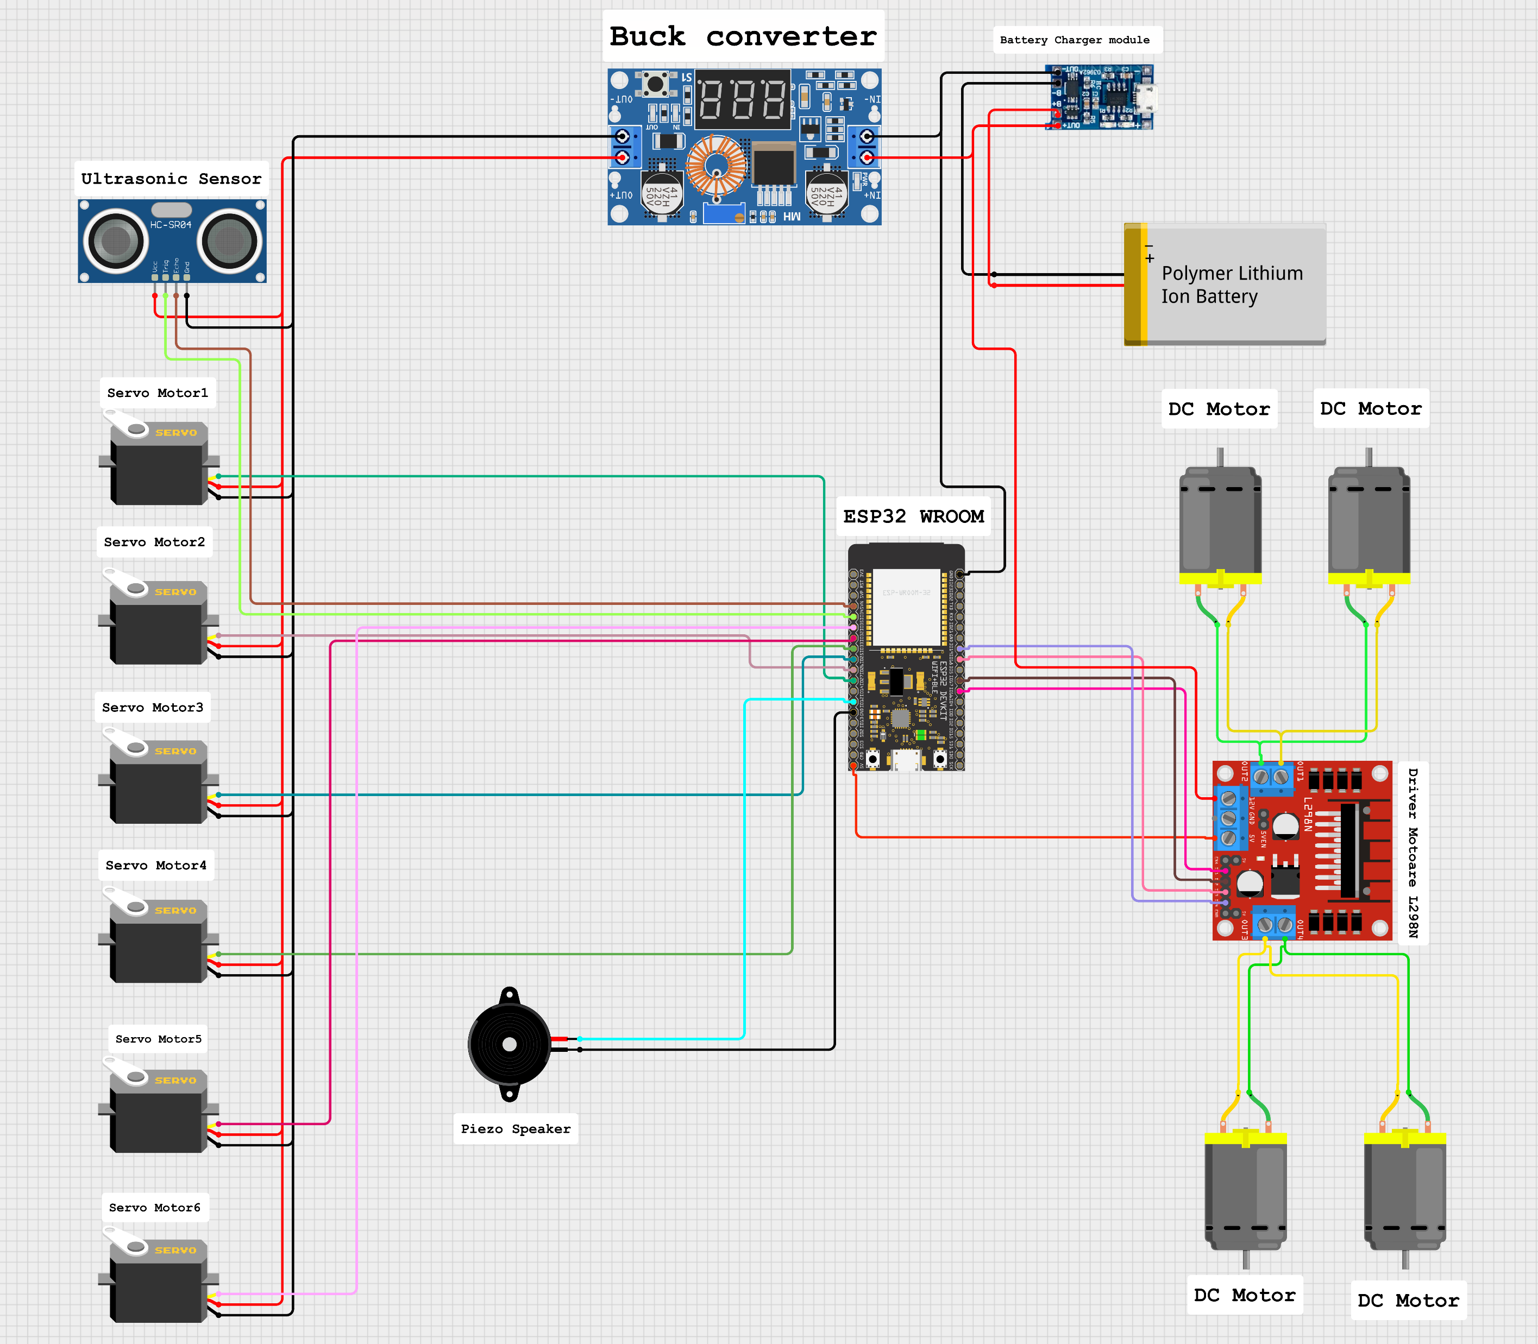
General schematic
Power supply
Arm action
Movement
Control

Slide 4
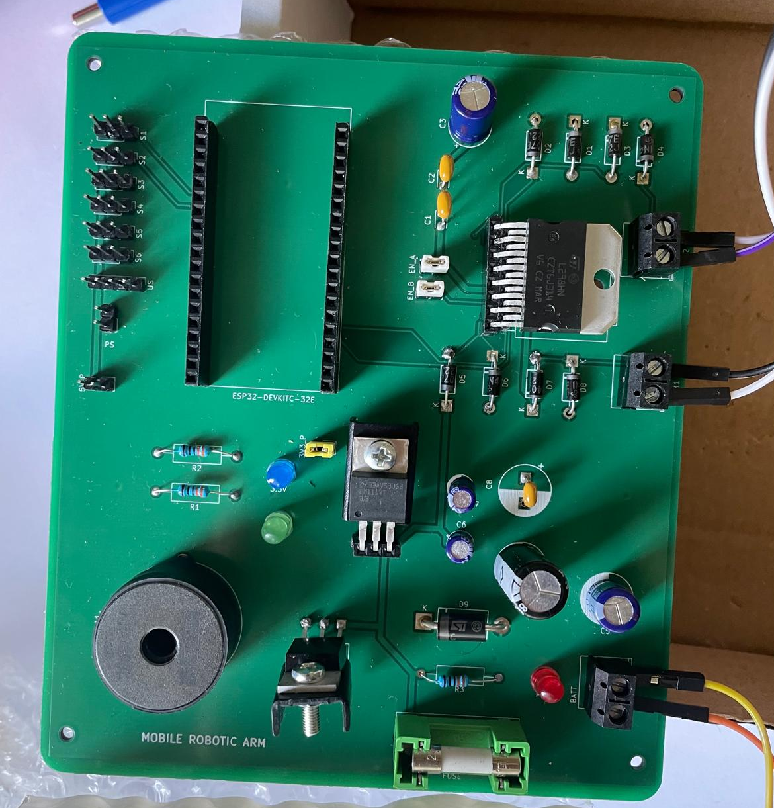
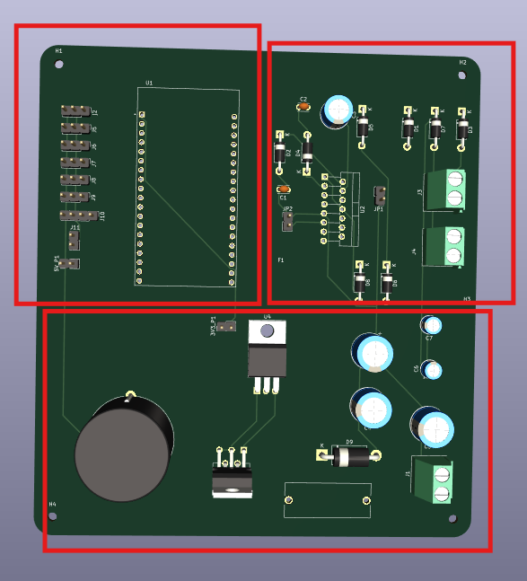
PCB design
3D View
Real-life view
Microcontroller + servo
Motor-driver
Power
supply

Slide 5
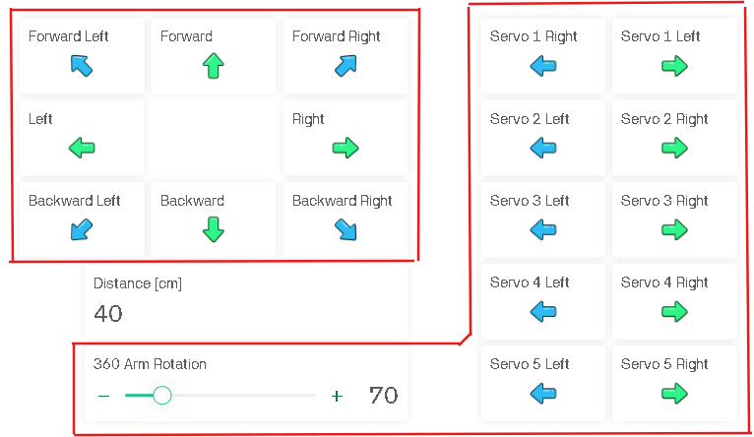
Control app (GUI)
Movement
Arm action
distance measurement + object detection

Slide 6

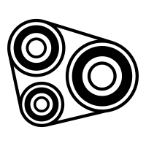
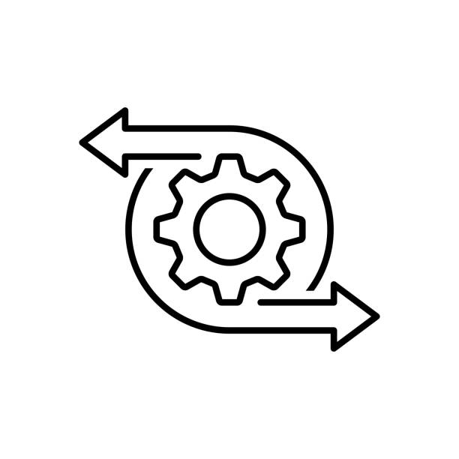
Key features
Power stability
Robust design
Flexibility and precision
Voltage regulators
Protection systems
High-quality parts
Forced stop system
Stability
Flexible arm movement
Remote control

Slide 7
Theory vs. reality

Slide 8
Improvements

Slide 9
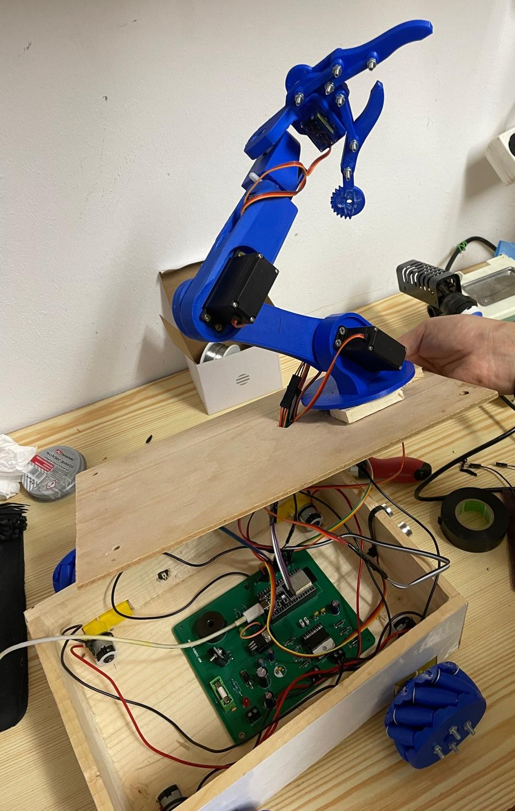
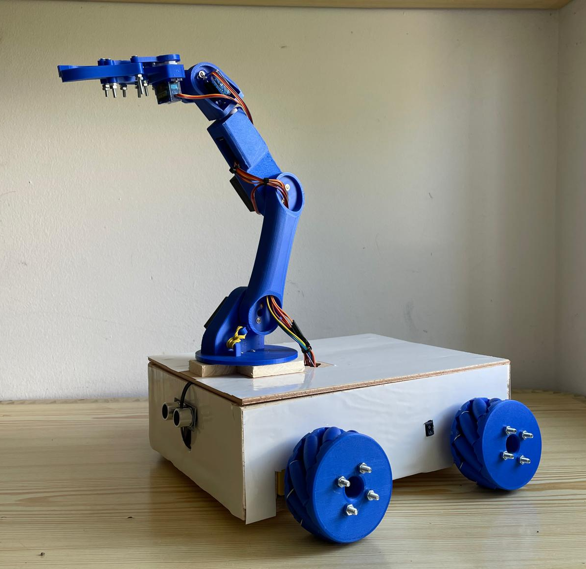
Ultrasonic sensor
ON/OFF button

Slide 10
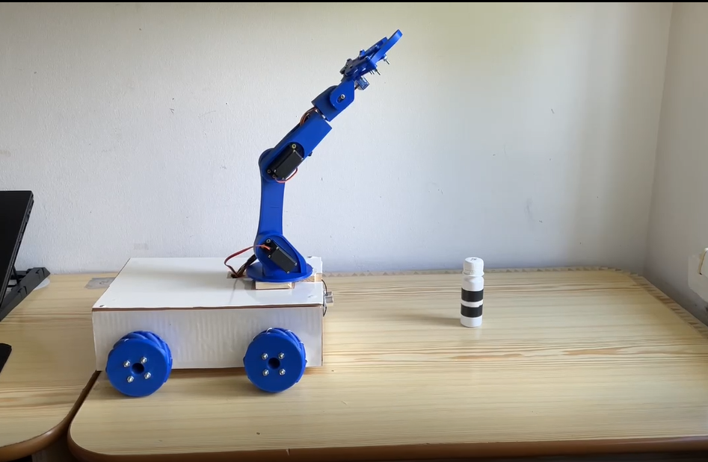
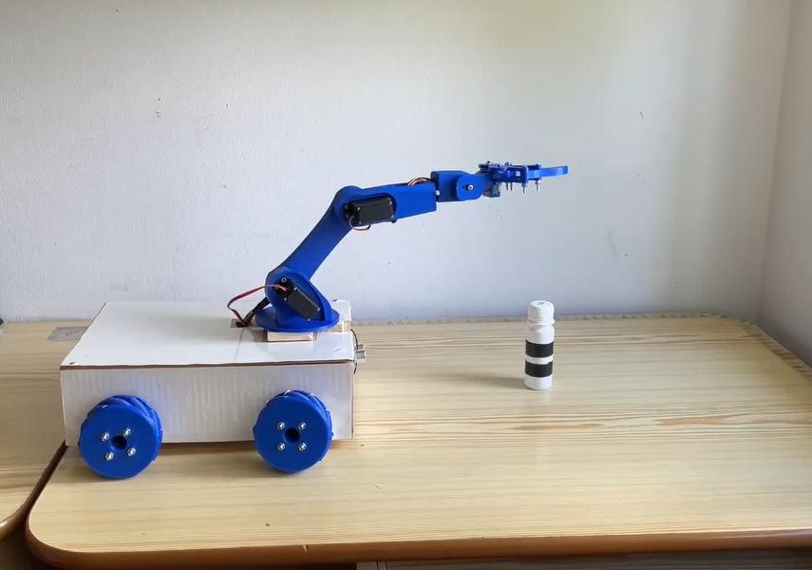
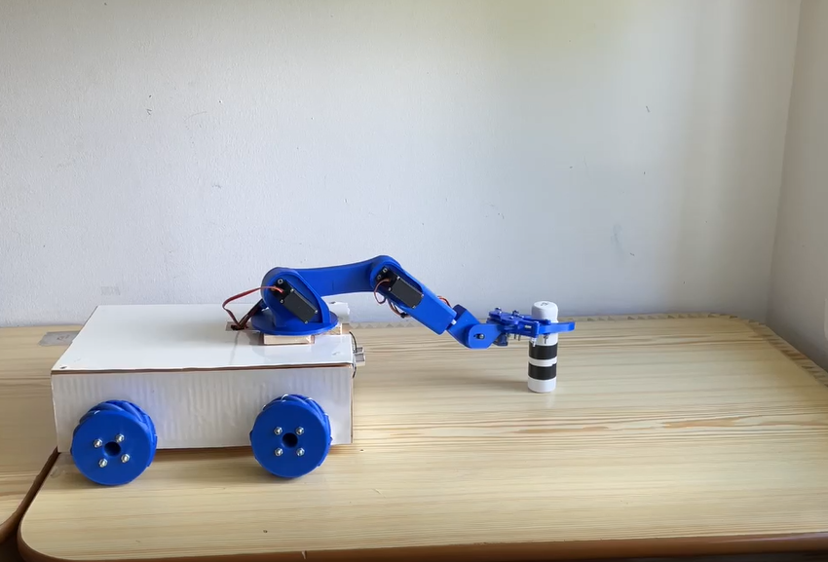
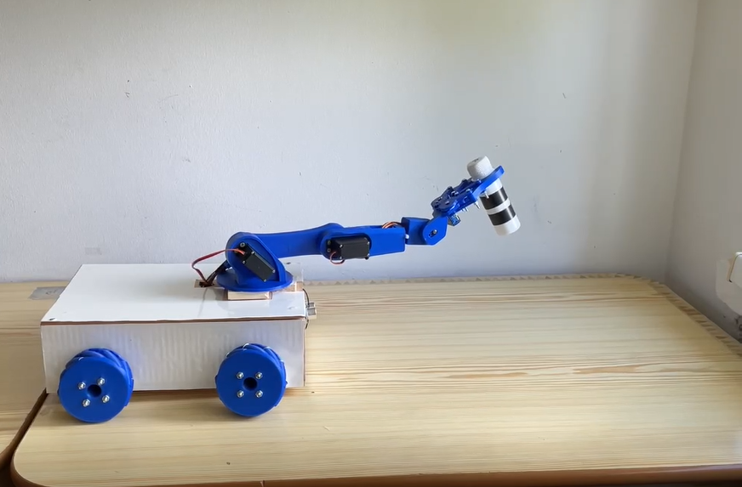
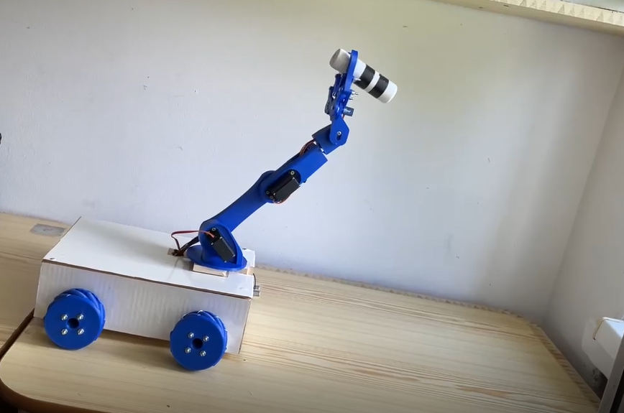
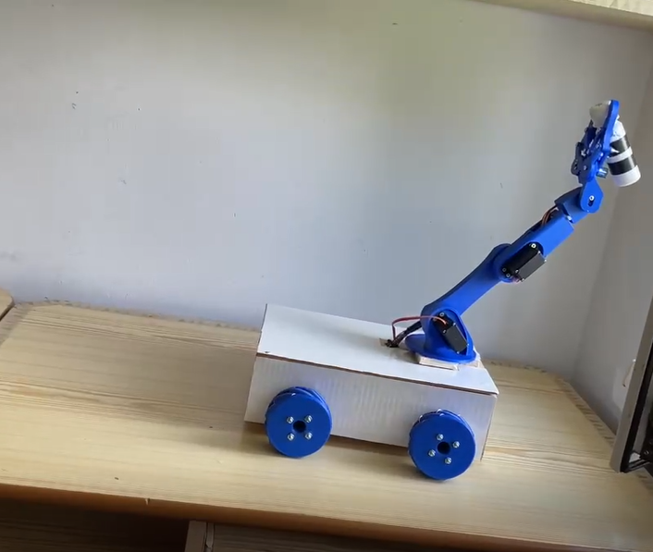
Frames

Slide 11
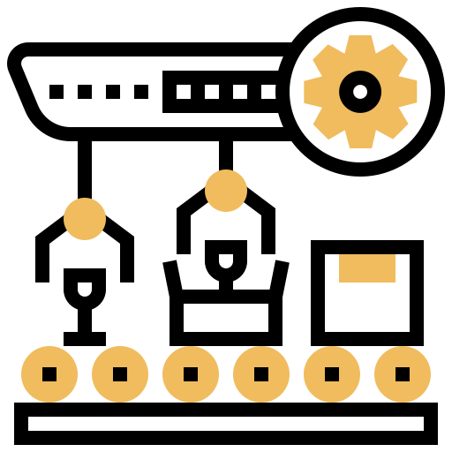
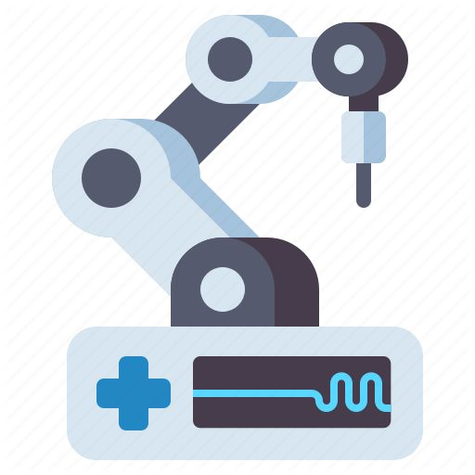
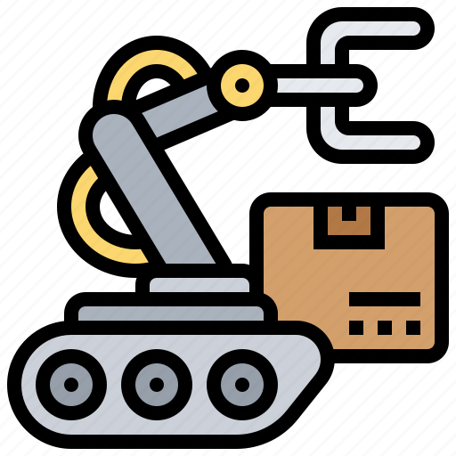
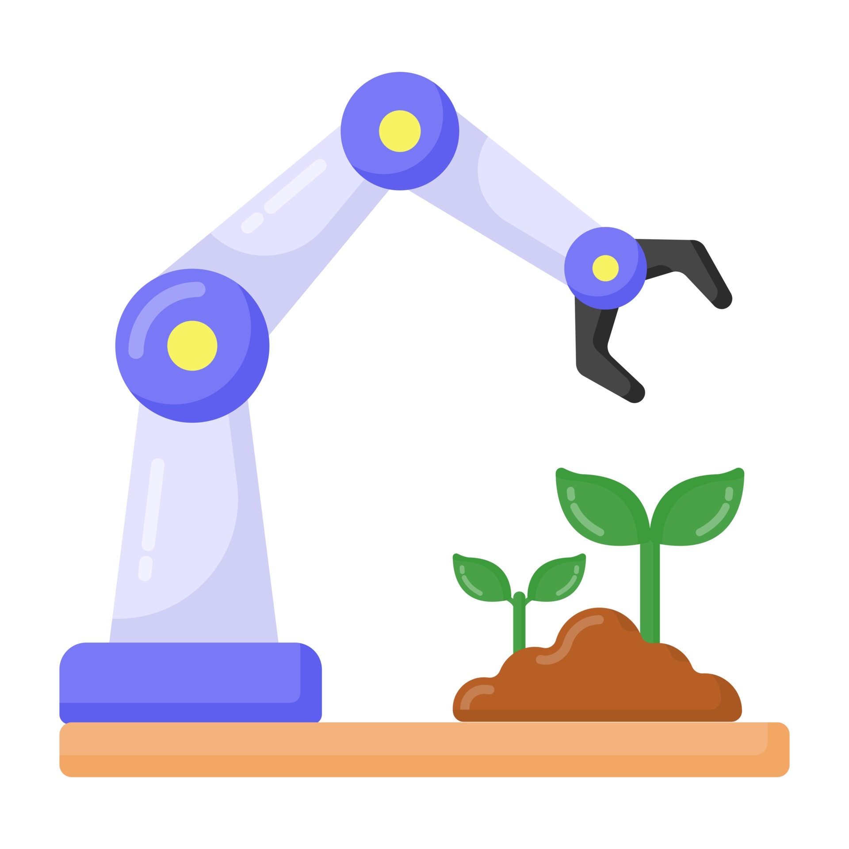




Real-world applications
Manufacturing
Healthcare
Assembly lines
Quality control
Distribution of medicines
Warehousing
Agriculture
Sorting and picking
Inventory management
Planting and harvesting
Monitoring
Agriculture

Slide 12
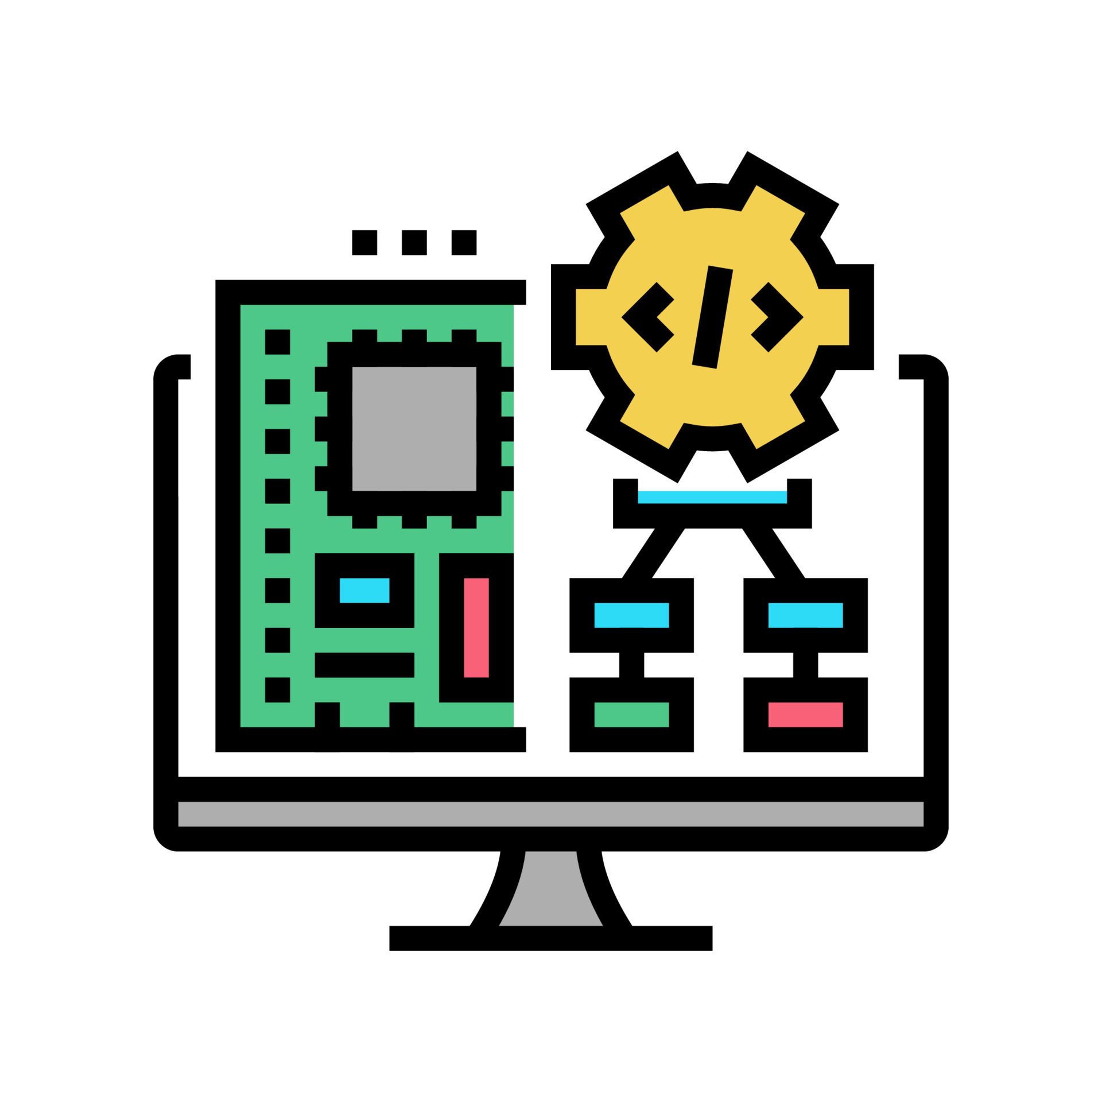

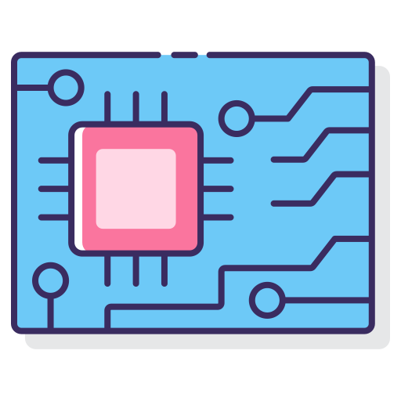








Skills acquired and competenceis
Software Development
Teamwork
PCB Design
Time management
V-cycle
Technical
Non-technical
Adaptability
3D Design
Problem-solving
Soldering Electronics
Networking

Slide 13



